Slide 1

Sync+ 2.0
U554–Desay_EESE&CVPP parts
China EESE&CVPP
Updated on 2022-04-25
Desired Outcome
Awareness
Decision
Escalation Help
Think
Point of view
Plan to Implement
Implement

Slide 2
{R09 PRO HF2} Software overall status {Yellow}
Software key info
  Refer SWAD for the details:
    MCU version:20220326_417_PRO
    SoC version:20220414_0666_DL13_R09.PRO.HF2_Debug
    Verification scope and method:
    {Full verification} executed with pass rate 98.31%, 1P1 and 48P2 issues found and not fixed. Refer test report for detail.
Highlights listed below:
    Open P1 issue list with risk evaluation – refer slide 3
    Open P2 issue list with risk evaluation – refer slide 4
    Performance Status– refer slide 5/6
    OTA Status– refer slide 7
Notes:
Add P1 weekly burn down chart

Slide 3
{R09 PRO HF2} Open P1 issue list with risk evaluation
Key | Summary | Priority | AIMS# | Remark
APIMCIS-16618 | MMOTA_China:MCU+calibration upgrade, activation fails, F10A cannot be upgraded | Immediate Gating |  | 问题原因：多VBF升级已合入正式版本，但目前只有CX727 Target包验证fail,经分析结果：由于fota app 崩溃导致没有升级成功。setting APP 被系统kill 了，然后又重新启动，与fota app 建立连接， 再升级过程中 fota app 向setting发送了一条消息，出现异常导致了 fota崩溃。 这个是所有车型都存在的问题 发生概率：Once 恢复机制：重新进行OTA升级即可恢复 风险评估：L，系统内存不足时才会出现setting被kill的情况；
Notes:
Add P1 weekly burn down chart

Slide 4

{R09 PRO HF2} Open P2 issue list with risk evaluation
Gating | 计数项:Status
Awaiting implementation | 13
In Progress | 19
Reopened | 2
Test | 11
To Do | 3
总计 | 48
U554 R09版本版本Gating问题修复30个
Notes:
Add P1 weekly burn down chart

Slide 5
{R09 PRO HF2} 性能测试状态
test item | Spec | Reference (0408) | R08 | R09 | Test Result
The time difference from Power Off state to having the home screen available | 12s | 15.8 | 18.0 | 19.65 | Fail
The time difference from Power Off state to having an already paired phone available 从Power Off到蓝牙连接上 | 12s | 30 | 29.12 | 31.23 | Fail
The time difference from Power Off state to navigation system available for user interaction |  | 28 | 32.7 | 33.1 | Fail
The time difference from Power Off state to BT media ready for user interaction 开机自动重连手机，手机端查看蓝牙时间，手动进入蓝牙音乐 |  | 30 | 29.8 | 30.2 | Fail
The time difference from Power Off state to the request for the last Audio source (BT Media) 睡眠后从点火到播放蓝牙音乐声音 |  | 34 | 38.7 | 36.0 | Fail
车辆设置界面-冷启动时间 |  | 23 | 26.5 | 25.5 | Fail
从输入密码到连接成功的时间 | 4s |  | 3.7 | 7.2 | Fail
无需输入密码直接连接成功的时间 | 4s |  | 3.6 | 6.9 | Fail
Notes:
Add P1 weekly burn down chart

Slide 6
{R09 PRO HF2} 性能测试状态
test item | Spec | Reference (0408) | R08 | R09 | Test Result
Power Off to 第一帧动画 (Power off相当于deep sleep) | 5s | 7 | 5.8 | 6.31 | Pass
The time difference from Power Off state to PTT ready硬按键 |  | 31 | 31.2 | 31.6 | Pass
The time difference from Power Off state to voice recognition ready语音唤醒 |  | 31 | 38.3 | 31.8 | Pass
The time difference from Power Off state to USB ready提示USB设备可用 手动进入U盘音乐（U盘根目录中两首歌曲），看到音乐列表 |  | 26 | 25.9 | 22.1 | Pass
The time diffenece from Power Off state to network connected完成时间同步 |  | 25 | 21.3 | 19.8 | Pass
The time difference from Power Off state to having the Rear-View-Camera (RVC) system ready respond to PRNDL events (for RVC) (CVBS/IPMB） | 2s | 6s | 6.3 | 6.7 | Pass
The time difference from Power Off state to the request for the last Audio source (AM/FM) to the Radio (via CAN bus or internal in a shared module) | 5s | 22 | 3.4 | 22.4 | Pass
The time difference from Power Off state to the request for the last Audio source (BT Media) |  | 34 | 42.1 | 35.12 | Pass
The time difference from Power Off state to the request for the last Audio source (USB Media) |  | 34 | USB音乐播放中，睡眠重启后不能恢复USB音乐播放 | 22.7 | Pass
全电台扫描时间 | 15s |  | 10.3 | 8.6 | Pass
已经存在的电台切换 FM to FM/AM to AM | 200msec |  | 151.7 | 187.7 | Pass
网络电台到FM/AM | 2.5s |  | 2.2 | 1.2 | Pass
已经存在的电台切换 FM to AM | 250msec |  | 236.3 | 241.7 | Pass
BT连接时间，从确认配对到播放BT音乐或者打电话的时间 | 6s |  | 5.660 | 5.975 | Pass
已经配对过的BT设备，从点连接到播放BT音乐或者打电话的时间 | 4s |  | 3.560 | 3.190 | Pass
同步BT联系人 500条 | 30s (每条联系人2个号码) |  | 9.870 | 11.040 | Pass
同步BT联系人 1000条 | 45s (每条联系人2个号码) |  | 18.060 | 16.830 | Pass
同步BT联系人 1500条 | 60s (每条联系人2个号码) |  | 28.450 | 23.410 | Pass
同步BT联系人6000-1W条 | 不能比SYNC（10分钟）慢S |  |  | 2min 32.74 | Pass
从插入u盘开始，扫描前100个USB本地文件后，用户手动选择第一个音乐/视频文件，能够开始播放第一帧的时间 | 2s |  | 1.4 | 1.5 | Pass
车机拨打、挂断电话后电话状态同步到手机界面的时间。（反之亦然） | 2s |  | 0.9 | 1.2 | Pass
电话启动时间 (homescreen准备后点击电话按钮到电话应用启动完毕) | 2s |  | 1.0 | 1.5 | Pass
点开WIFI开关后到扫描出所有热点的时间 | 5s |  | 1.5 | 3.4 | Pass
断开wifi热点的时间 | 200msec |  | 162.0 | 200.0 | Pass
IVI主机运行时，RVC显示时间(CVBS/IPMB） | <750msec |  | 789.7 | 712.3 | Pass
从接受到信号到相应HMI status image coding 显示的时间 | <750msec |  | 443.0 | 477.7 | Pass
Notes:
Add P1 weekly burn down chart

Slide 7
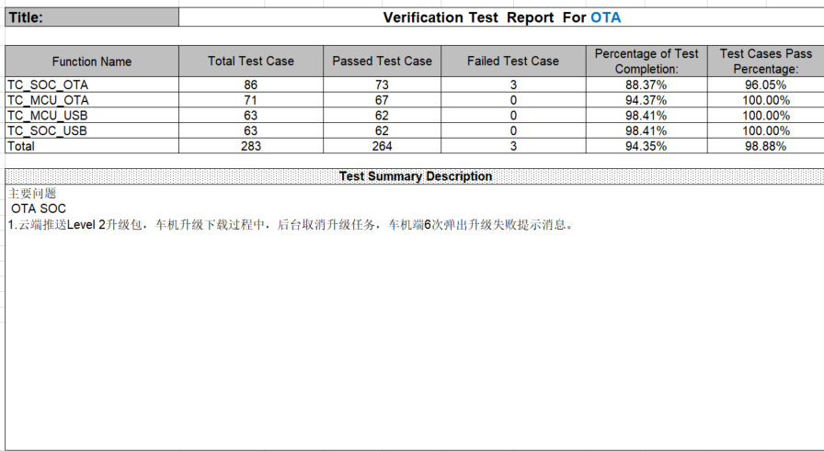
{R09.PRO HF2} OTA测试状态
Notes:
Add P1 weekly burn down chart

